Slide 1
Lecture 4: Option Pricing
人工智慧理論與實務

Slide 2
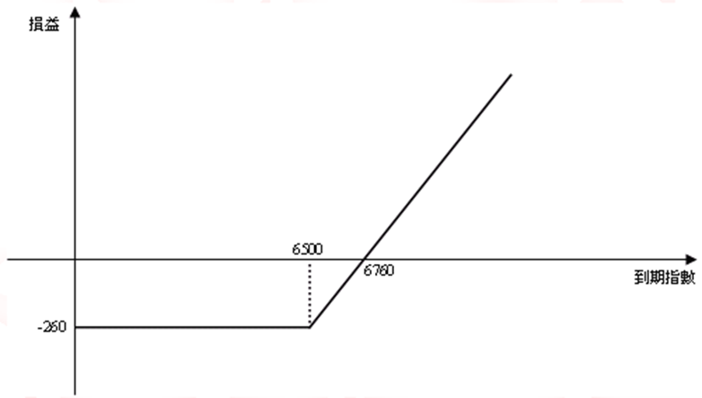
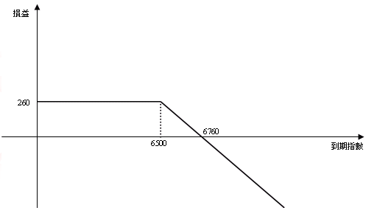
4.0 Recap
Call (買權)
 | 買進 | 賣出
情況 | 預期大漲時 | 預期小跌時
圖形 | 買進一口4月到期，履約價為6500，權利金為260點的買權 | 賣出一口4月到期，履約價為6500，權利金為260點的買權

Slide 3
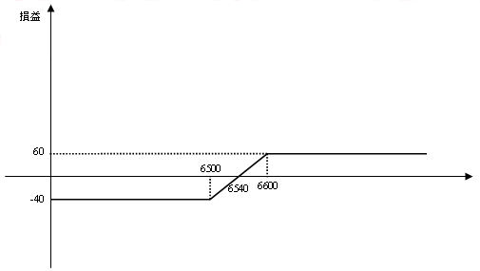
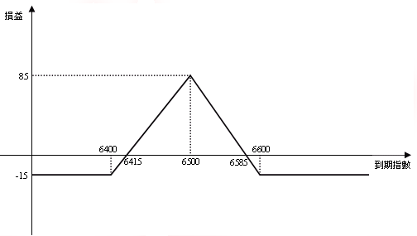
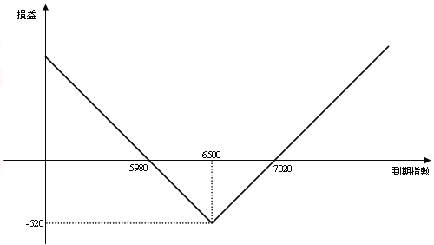
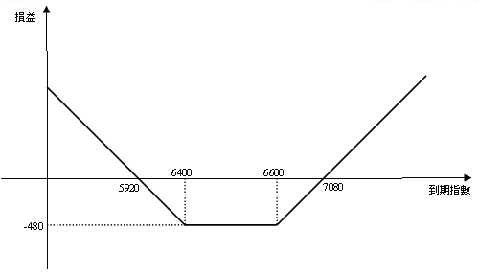
4.0 Recap
Spread、Straddle、Strangle

Slide 4
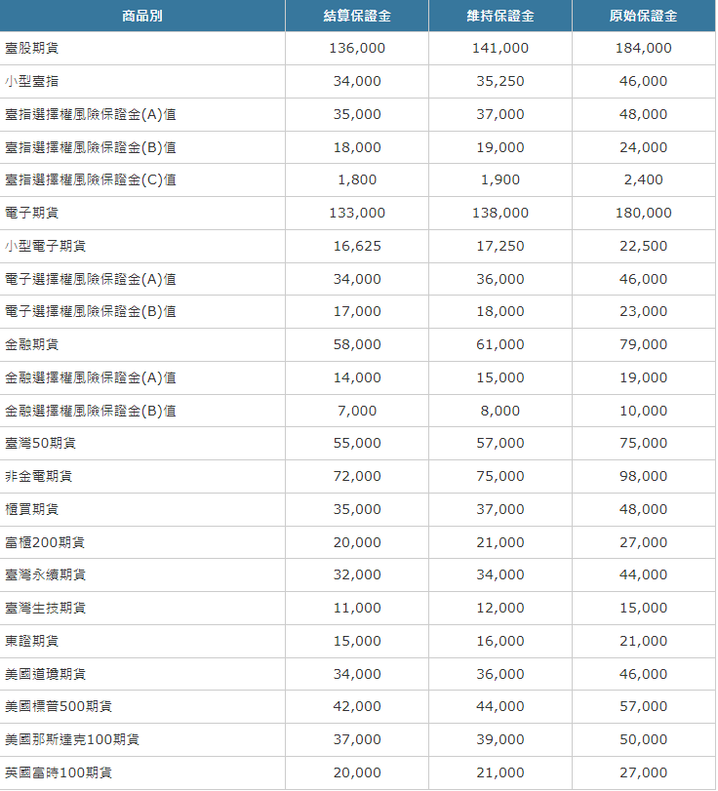
保證金交易

Slide 5
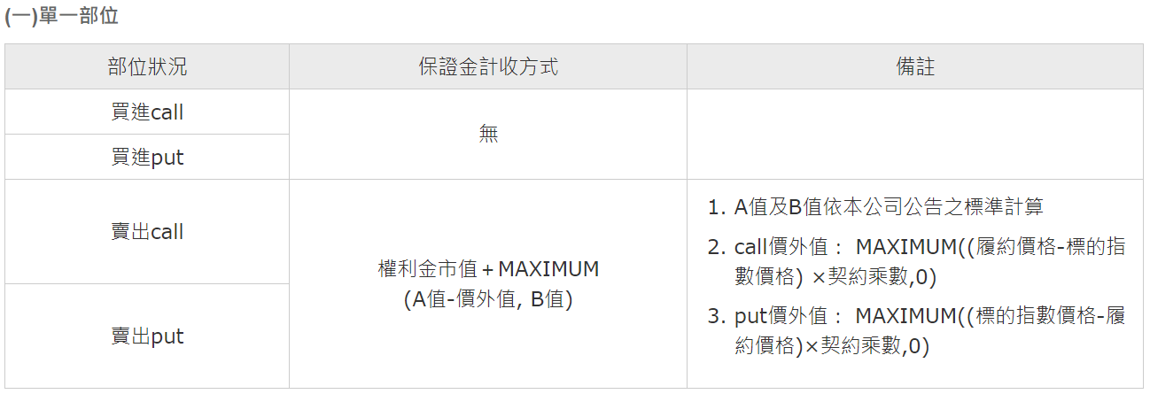
保證金交易

Slide 6
4.0 Objectives
The purpose of this lecture is to give students:
an introduction to the Black Scholes (BS) option pricing model;
an introduction to the Greeks;
Learning Outcomes Statements (LOS):
Will have a basic knowledge of the formula of BS Model;
Will have a brief idea of the model’s assumptions, parameters, & features;
Will understand the relationship of the option value with different parameters;
Will understand the factors affect the Greeks.
Will understand how to program the above formulas.
Notes:
Detail learning objectives?

Slide 7
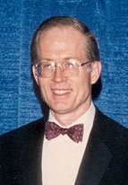


4.1 Black-Scholes Model (background)
The Black-Scholes or Black-Scholes-Merton model was a major breakthrough in the pricing of European stock options in the early 1970s.*
An important milestone for finance, risk management that the major contributors, Merton^ and Scholes^, received the 1997 Nobel Memorial Prize in Economic Sciences. (Although ineligible for the prize because of Black’s death in 1995, he was mentioned as a contributor by the Swedish Academy.)
“Robert C. Merton and Myron S. Scholes have, in collaboration with the late Fischer Black, developed a pioneering formula for the valuation of stock options. Their methodology has paved the way for economic valuations in many areas. It has also generated new types of financial instruments and facilitated more efficient risk management in society.” Press Release from The Royal Swedish Academy of Sciences (1997)
*See Black, F., & Scholes, M., 1973, “The Pricing of Options & Corporate Liabilities,” Journal of Political Economy, 81, 637-59; Merton, R.C., 1973, “Theory of Rational Option Pricing,” Bell Journal of Economics & Management Science, 4, 141-83
^Merton & Scholes were principals at LTCM, the hedge fund that was bailout in 1998 and liquidated in 2000.

Slide 8
4.1 Black-Scholes Model
The basic model of BS Model.
Assumptions:
European-style options (ie. Only can exercise at expiration).
Percentage changes in the stock prices in a short period of time are normally distributed.
So that, the stock price at a future time T, S_{T}, has a lognormal distribution (Geometric Brownian motion).
Continuously compounded return is used.
No transaction costs, tax.
No dividend is paid (can be relaxed for extended model).

Slide 9
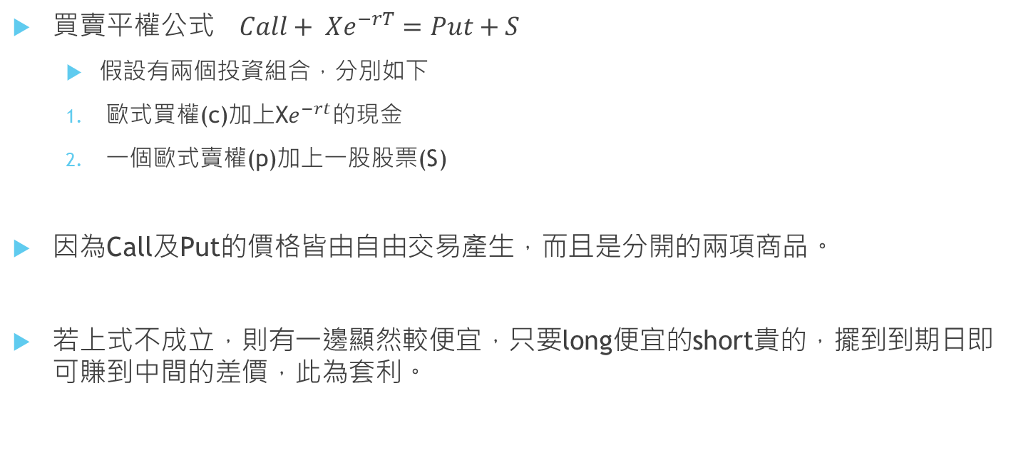
4.1 Put-call parity
買賣平權公式$Call+ {Xe}^{−rT}=Put+S$
假設有兩個投資組合，分別如下
歐式買權(c)加上X$e^{−rt}的$現金
一個歐式賣權(p)加上一股股票(S)
因為Call及Put的價格皆由自由交易產生，而且是分開的兩項商品。
若上式不成立，則有一邊顯然較便宜，只要long便宜的short貴的，擺到到期日即可賺到中間的差價，此為套利。

Slide 10

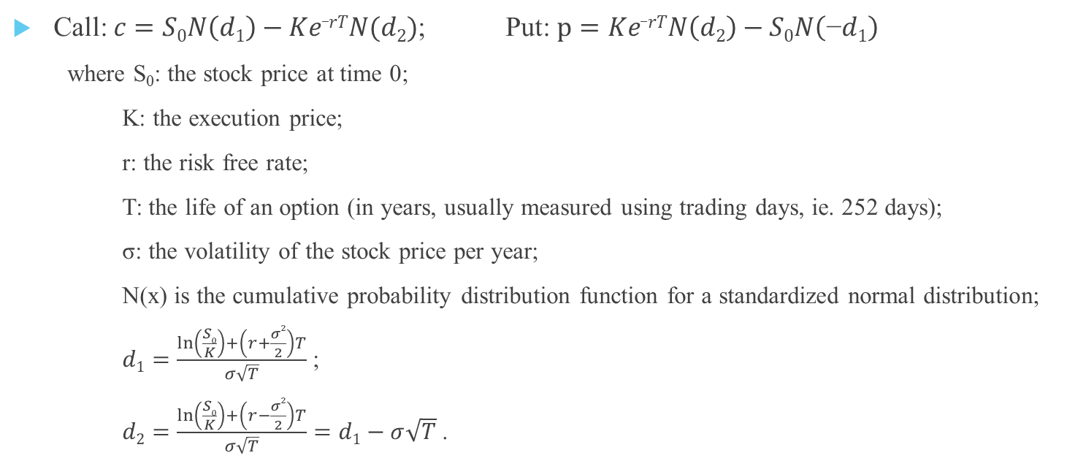
4.1 Black-Scholes Formulas
Call: $c=S0N\left(d1\right)−Ke_rTN(d2)$; Put: $p=Ke_rTN\left(d2\right)−S0N\left(\text{−}d1\right)$
where S₀: the stock price at time 0;
K: the execution price;
r: the risk free rate;
T: the life of an option (in years, usually measured using trading days, ie. 252 days);
σ: the volatility of the stock price per year;
N(x) is the cumulative probability distribution function for a standardized normal distribution;
$d1=\frac{\ln\left(\frac{S0}{K}\right)+\left(r+\frac{σ2}{2}\right)T}{σ\sqrt{T}}$ ;
$d2=\frac{\ln\left(\frac{S0}{K}\right)+\left(r−\frac{σ2}{2}\right)T}{σ\sqrt{T}}=d1−σ\sqrt{T}$ .

Slide 11
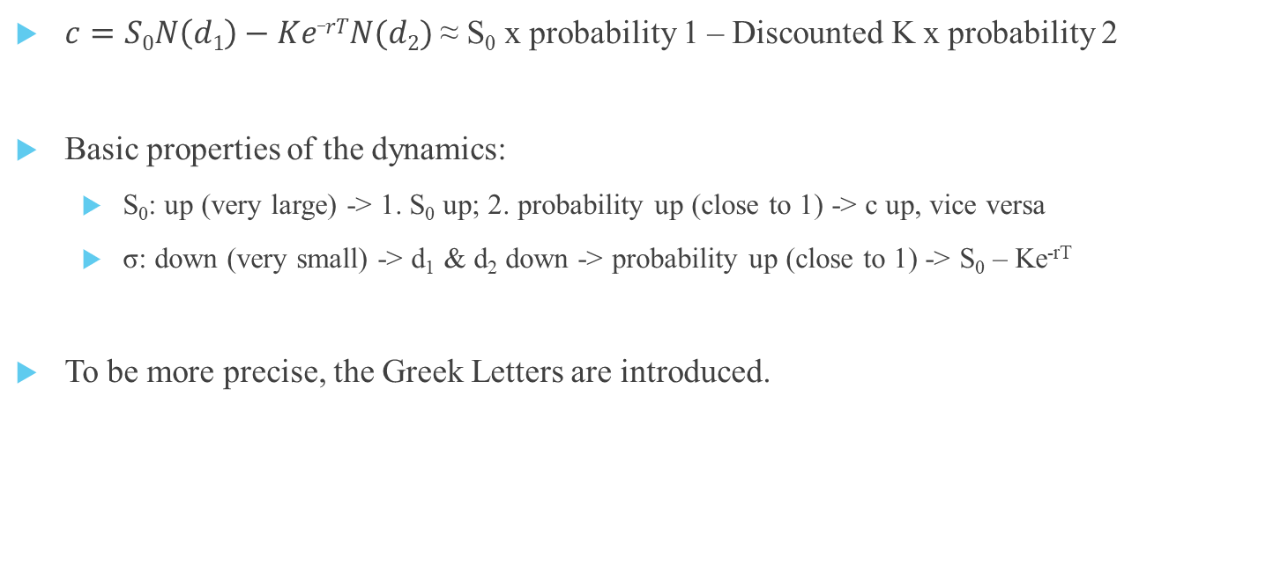
4.1 Black-Scholes Formulas (The Properties)
Receive
Pay
$c=S0N\left(d1\right)−Ke_rTN(d2)$ ≈ S₀ x probability 1 – Discounted K x probability 2
Basic properties of the dynamics:
S₀: up (very large) -> 1. S₀ up; 2. probability up (close to 1) -> c up, vice versa
σ: down (very small) -> d₁ & d₂ down -> probability up (close to 1) -> S₀ – Ke^{-rT}
To be more precise, the Greek Letters are introduced.

Slide 12
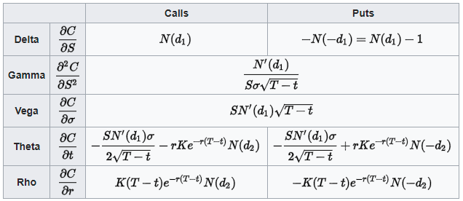
4.2 The Greek Letters (Overview)
"The Greeks" measure the sensitivity of the value of an option to the changes in parameter value while holding the other parameters fixed.
Note 1: T-t here means the period from today to the expiration date, ie. the T of BS formula on slide 5; where S is S₀ on slide 5

Slide 13
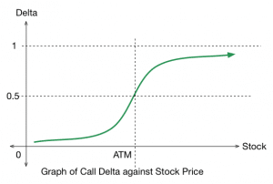
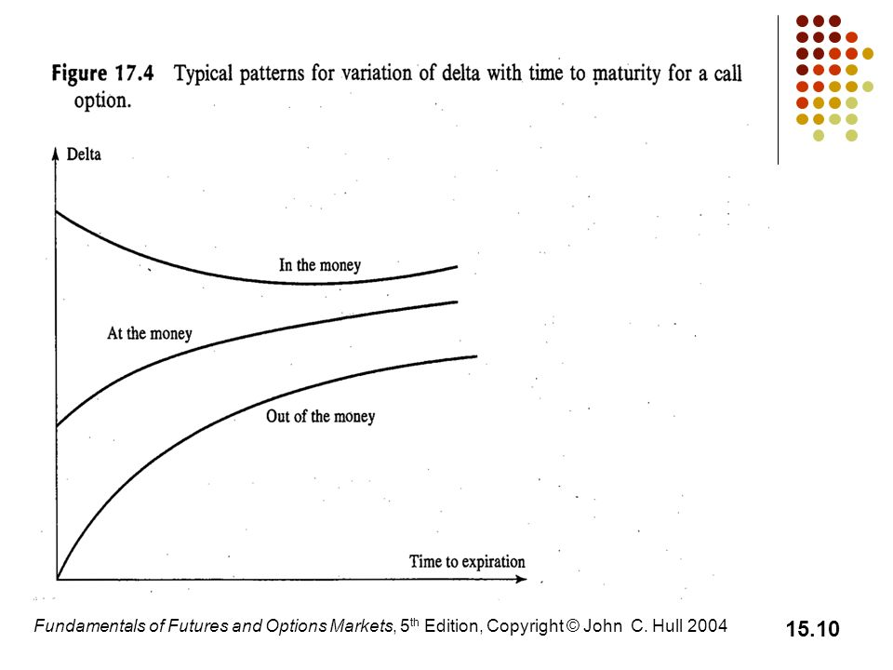
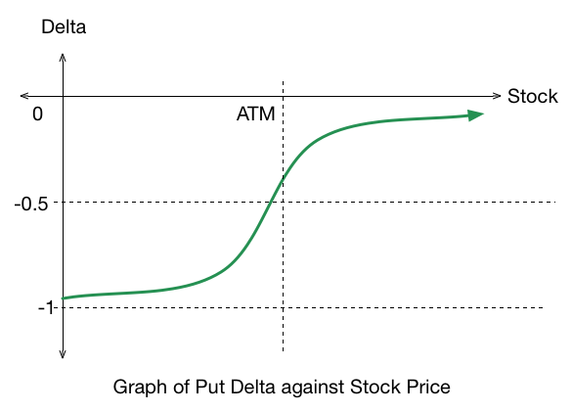
4.2.1 The Greeks (Delta)
Delta: the sensitivity of the option price to a change in the price of the underlying security.

Slide 14
4.2.1 Applications: Delta-Hedging
The idea of Delta-Hedging:
Note: it is impractical to hedge continuously; instead, we hedge periodically. Periodic or discrete hedging but results with some replication error.
portfolio
Rebalance:
(continuously)
always
option + stock
the total delta = 0

Slide 15
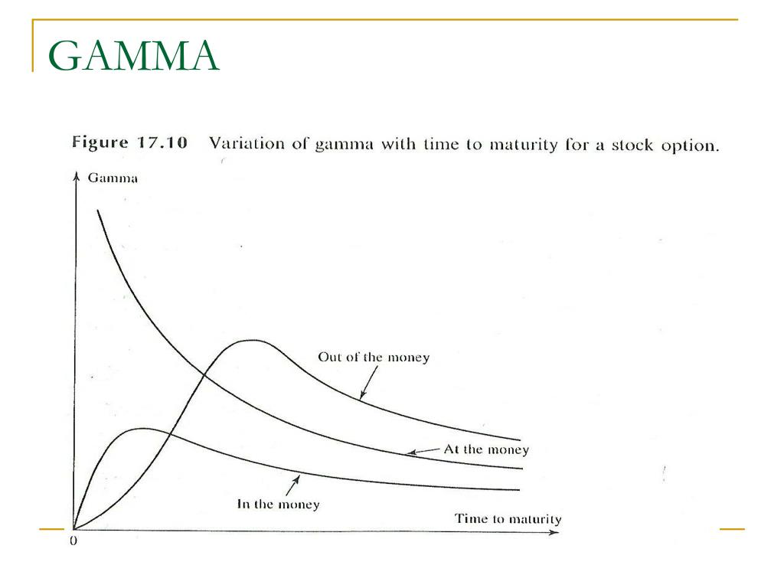
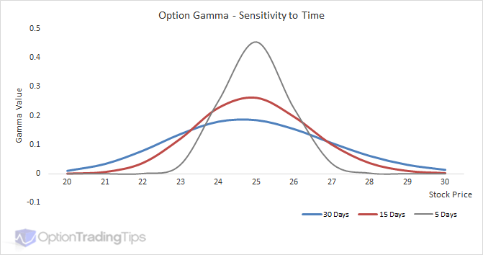
4.2.2 The Greeks (Gamma)
Gamma: the sensitivity of the option's delta to a change in the price of the underlying security.
K

Slide 16
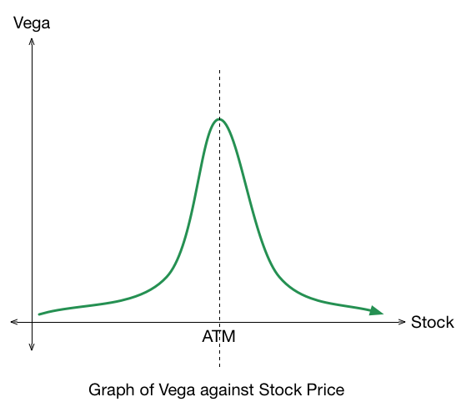
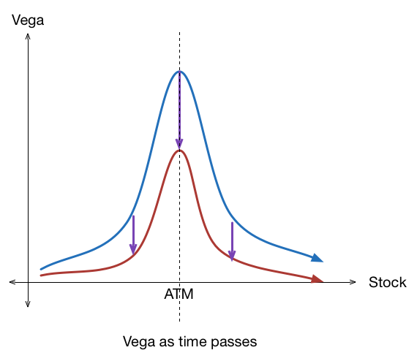
4.2.3 The Greeks (Vega)
Vega: the sensitivity of the option price to a change in volatility.

Slide 17
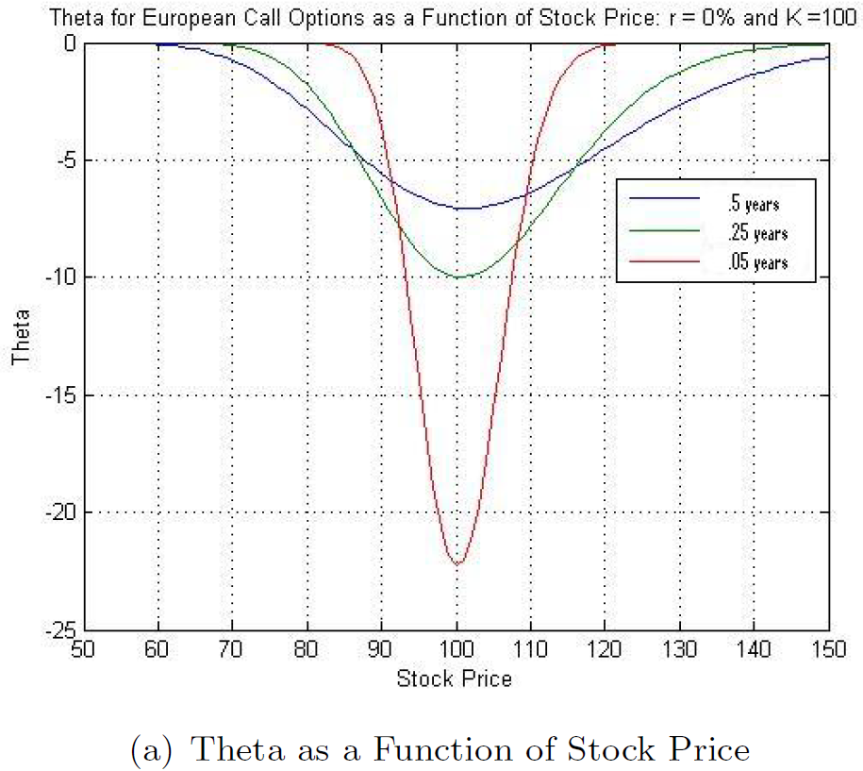
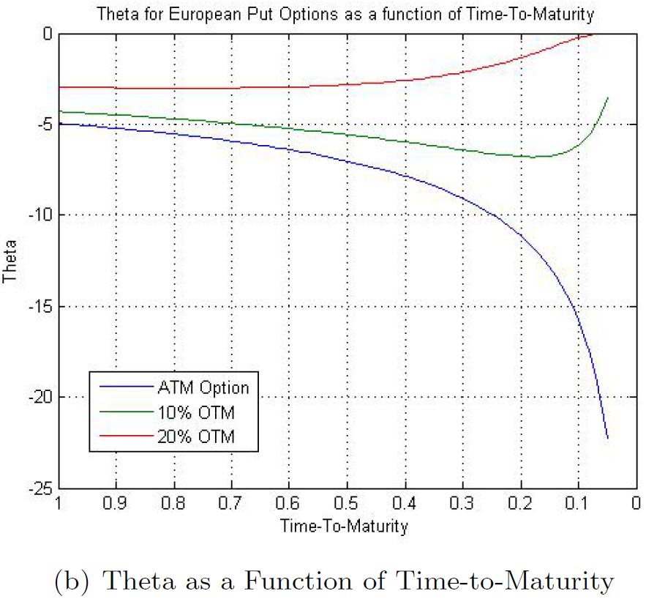
4.2.4 The Greeks (Theta)
Theta: the sensitivity of the option price to a negative change in time-to-maturity (the "time decay".

Slide 18
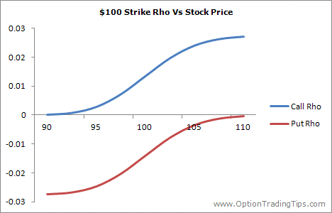
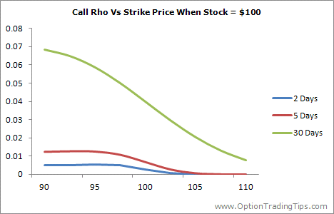
4.2.5 The Greeks (Rho)
Rho: the sensitivity of the option price to the interest rate.

Slide 19
4.3 Monte Carlo Stimulation (Introduction)
One of the most important and popular numerical methods in scientific computing;
First used in Manhattan project, then for the development of Hydrogen bomb;
Advantage:
Widely used in quantitative finance, and even more popular recently with the rise of GPUs;
Especially useful when number of random elements in the valuation problem is two great to permit direct numerical valuation;
Underlying variables are distributed in such a way that direct solutions are difficult;
The payoff depends on the path of underlying asset price
Disadvantage:
Monte Carlo valuation of American options is not easy, although it can be done;
Somehow inefficient which requires many simulated values for the option price to converge.
Note: This lecture slides are prepared based on Chapter 13, & 20 of “Options, Futures, & Other Derivatives” by J. Hull, Pearson, 7th Edition, 2012; and Chapter 5 of “財務工程與金融計算” by 張焯然, Securities & Futures Institute, RoC, 2007.

Slide 20
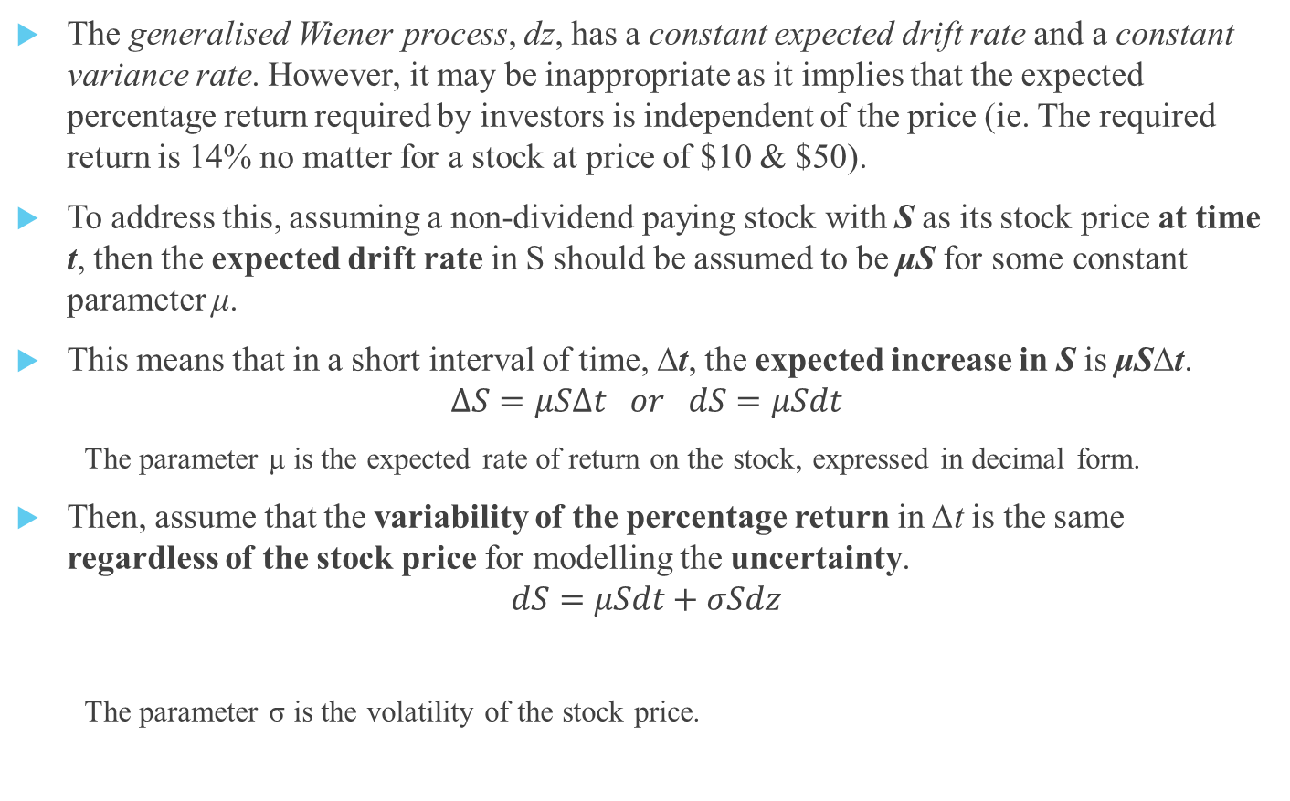
4.3.1 The Idea of Monte Carlo
The generalised Wiener process, dz, has a constant expected drift rate and a constant variance rate. However, it may be inappropriate as it implies that the expected percentage return required by investors is independent of the price (ie. The required return is 14% no matter for a stock at price of $10 & $50).
To address this, assuming a non-dividend paying stock with S as its stock price at time t, then the expected drift rate in S should be assumed to be μS for some constant parameter μ.
This means that in a short interval of time, ∆t, the expected increase in S is μS∆t.
$$∆S=μS∆t or dS=μSdt$$
The parameter μ is the expected rate of return on the stock, expressed in decimal form.
Then, assume that the variability of the percentage return in ∆t is the same regardless of the stock price for modelling the uncertainty.
$$dS=μSdt+σSdz$$
The parameter σ is the volatility of the stock price.
Change in the Stock Price
Drift Coefficient
Random Shock

Slide 21
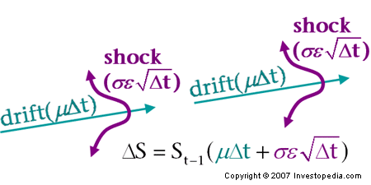
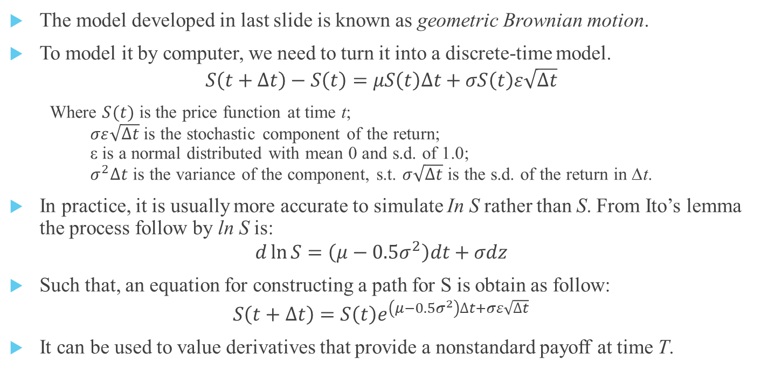
4.3.2 Discrete-Time Model
The model developed in last slide is known as geometric Brownian motion.
To model it by computer, we need to turn it into a discrete-time model.
$$S\left(t+∆t\right)−S\left(t\right)=μS\left(t\right)∆t+σS\left(t\right)ε\sqrt{∆t}$$
Where $S(t)$ is the price function at time t; $σε\sqrt{∆t}$ is the stochastic component of the return; ε is a normal distributed with mean 0 and s.d. of 1.0; $σ^{2}∆t$ is the variance of the component, s.t. $σ\sqrt{∆t}$ is the s.d. of the return in ∆t.
In practice, it is usually more accurate to simulate In S rather than S. From Ito’s lemma the process follow by ln S is:
$$d\ln{S}=\left(μ−0.5σ^{2}\right)dt+σdz$$
Such that, an equation for constructing a path for S is obtain as follow:
$$S\left(t+∆t\right)=S\left(t\right)e^{\left(μ−0.5σ^{2}\right)∆t+σε\sqrt{∆t}}$$
It can be used to value derivatives that provide a nonstandard payoff at time T.
(5.6)
(5.7)

Slide 22
4.3.3 Stimulation Demo
Souce: Lecture 3 of Econ136 of Harvey Mudd College (Visited on 18 Oct 2020), https://www.palmislandtraders.com/econ136/e136ls.htm

Slide 23
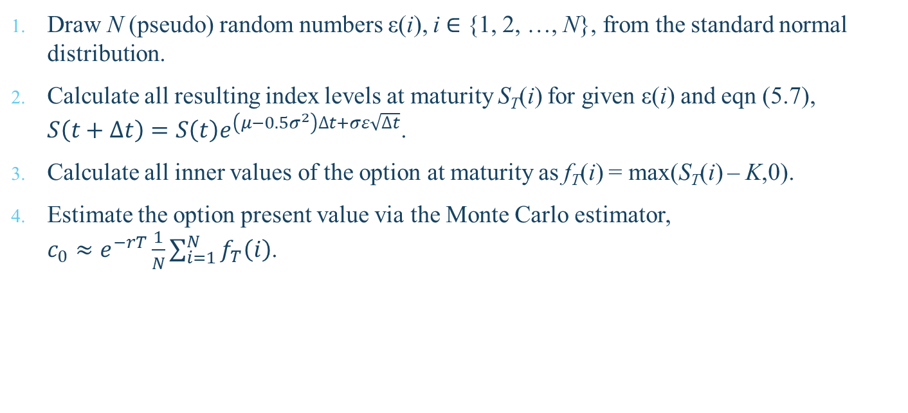
4.3.4 Algorithm for Pricing an European Call
Draw N (pseudo) random numbers ε(i), i ∈ {1, 2, …, N}, from the standard normal distribution.
Calculate all resulting index levels at maturity S_{T}(i) for given ε(i) and eqn (5.7), $S\left(t+∆t\right)=S\left(t\right)e^{\left(μ−0.5σ^{2}\right)∆t+σε\sqrt{∆t}}$.
Calculate all inner values of the option at maturity as f_{T}(i) = max(S_{T}(i) – K,0).
Estimate the option present value via the Monte Carlo estimator, $c_{0}≈e^{−rT}\frac{1}{N}\sum_{i=1}^{N}{f_{T}\left(i\right)}$.

Slide 24
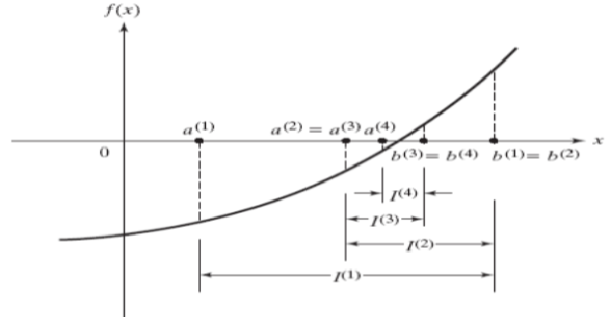
Bi-section

Slide 25
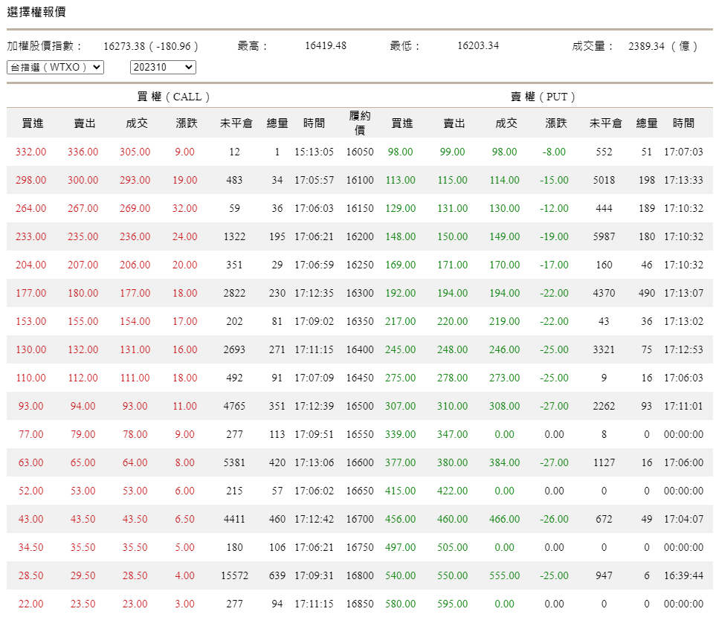

Slide 26
Homework
承繼上週的資料，試以履約價16500的買權輔以合理的參數設定，來計算此選擇權的隱含波動率
試用Bi-section方法結合Black-Scholes公式解，求得精準度在10⁻⁵以下的implied volatility
使用第一步計算的波動率，用Monte Carlo Simulation算出選擇權價格（從S₀到S_{T}切分N=100個step，總共進行M=1000次模擬），重覆算10次平均，並算出其與93.0的誤差
試設計一個小實驗，驗證N跟M的值變動時，誤差會如何跟著改變
算出履約價16100, 16200, … , 16800買權的隱含波動率，繪製以履約價為X軸、隱含波動率為Y軸的折線圖，並回答是否有volatility smile的現象。
將程式碼與不超過2頁的報告，在10/18上課前上傳至E3

